Slide 1
Content-Based Image Retrieval
- Avtansh Pandey

Slide 2
Video Links
Video 1 – Understanding (Start – 00:37): https://www.youtube.com/watch?v=61pUX7_LKZg&t=314s
Video 2 – Implementation (Start – 01:45): https://www.youtube.com/watch?v=vsaHwpYP7wQ
Video 3 – Tesla Data Engine (Start – 08:15) : https://www.youtube.com/watch?v=hx7BXih7zx8&t=876s

Slide 3
What is CBIR?
CBIR (Content based image retrieval) also known as query based image retrieval is a way of querying image databases using visual properties of an image as ‘search-terms’.
It returns images from a database that share the same or similar visual properties.
Before CBIR, text-based image retrieval was a widely used technique which involved searching images based on tags which lacked accuracy and was labor intensive.
The term "content" in this context might refer to colors, shapes, textures, or any other information that can be derived from the image itself. CBIR is desirable because searches that rely purely on metadata are dependent on annotation quality and completeness.

Slide 4
Features
To perform CBIR, we need to extract features of the image.
Features are classified into three types in image processing, that is low, middle and high.
Low level features – Color, texture
Middle level features – Shape
High level features – Semantic gap of objects
Feature vector is used to store the extracted features as matrix format in database for processing. Feature extraction is working with matrix, histogram, Transformation, Rotation, Segmentation, Region of Interest, Region of Center of the image.

Slide 5
Retrieval Methods
SIFT (Scale Invariant Feature Transform)
Deep Learning
Earlier this method was used for retrieval. SIFT feature vectors are extracted from each original image, and then feature vectors are constructed. When a query image is given, SIFT feature vector is established for the query image, and then we search for the feature vector library to obtain visual similarly images. Afterwards, visual similarly images are returned to the user according to visual similarity computing results.
This made SIFT labor intensive method as it involved creating feature vectors too.
Deep learning techniques like CNN (Convolutional neural networks) have proved themselves efficient when it comes to processing images for purposes like detection, classification etc. They effectively extract features as feature vectors, which can be tapped from the layer just before the fully convolutional network and then can be further used with other distance metric algorithms to retrieve similar images.
The automation and accuracy of the feature extraction process has lead to its adaptation for all such image retrievals.

Slide 6
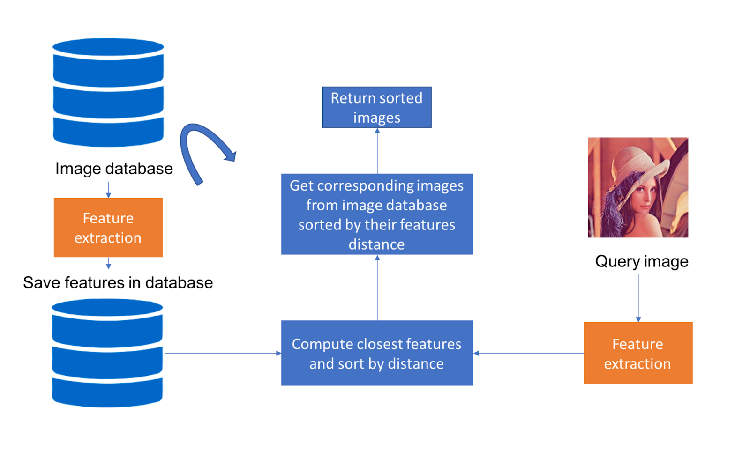

Slide 7
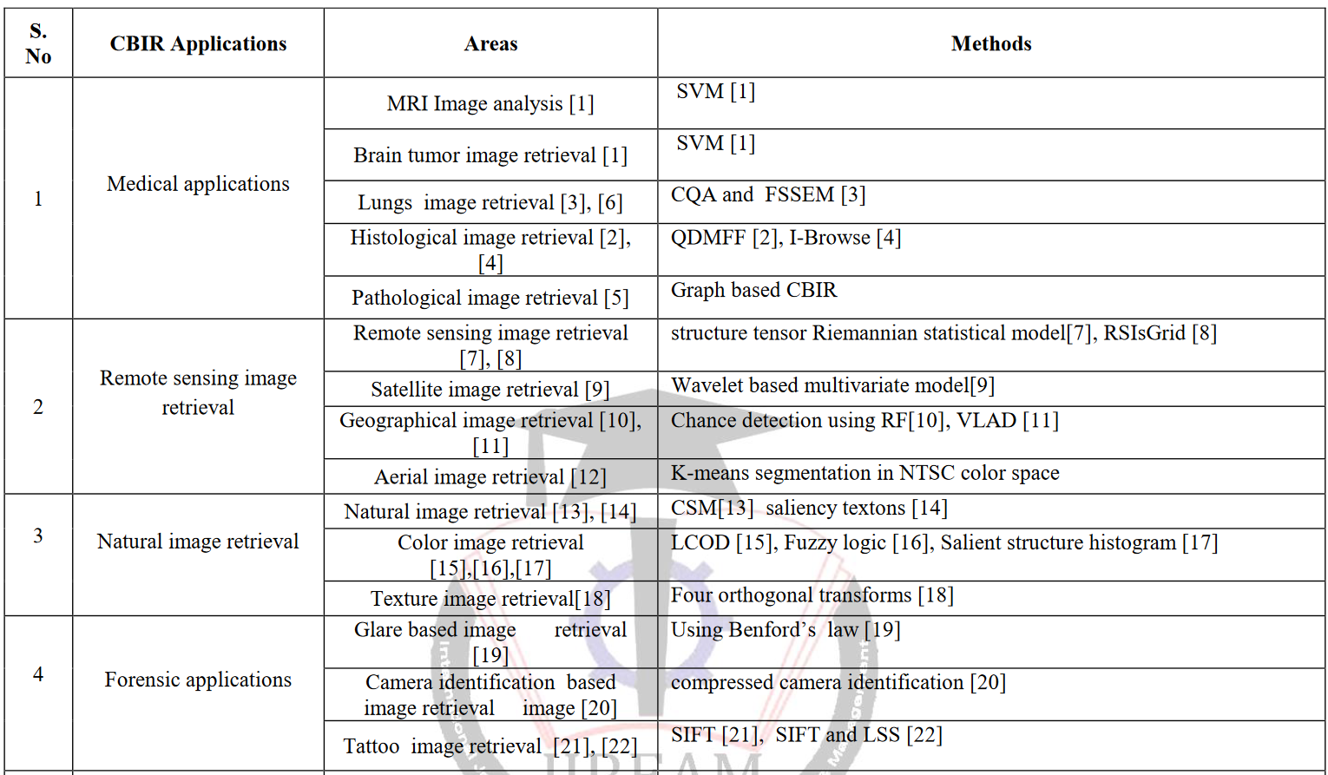

Slide 8
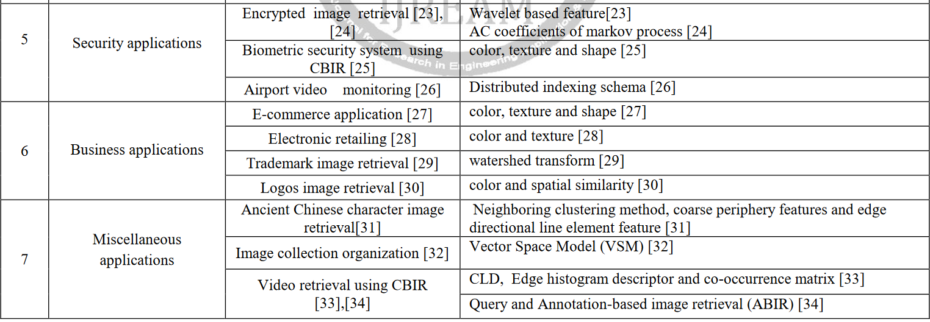

Slide 9
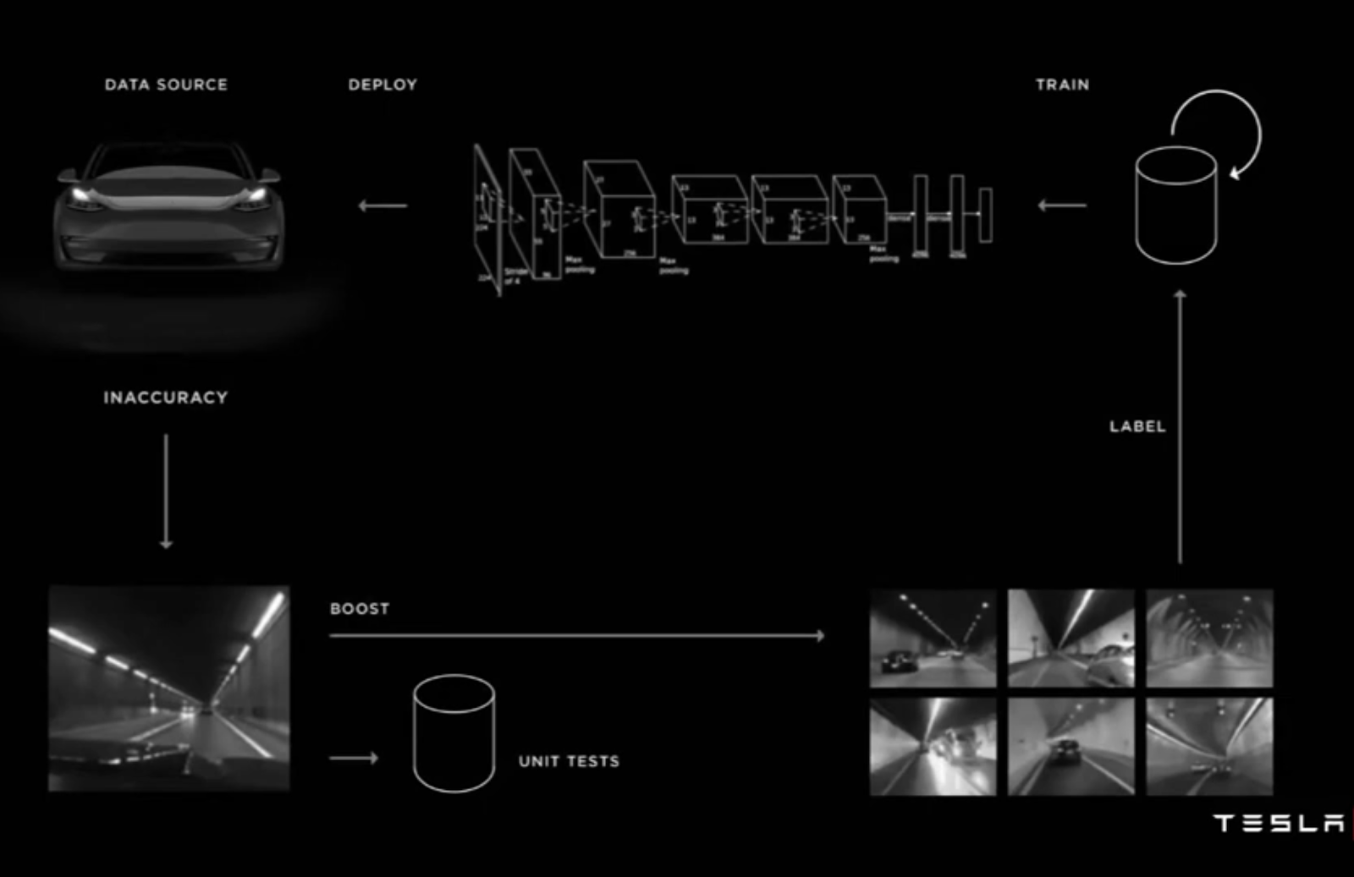
Tesla – Data Engine Model

Slide 10
Thankyou!

